Slide 1
Introduction to Open Source, Git and GitHub

Slide 2


Rushan Khan
Mentor at GirlScript Summer Of Code 2021

Slide 3

Open Source
Something that is designed to be publicly available.
Can be viewed by anyone.

Slide 4
Philosophy of Open Source
Promotes the FSF philosophy of “software should be free.”
Open Source is all about collaboration.
“Collaboration first, code second”

Slide 5
Disadvantages of Open Source
People might “steal” your product and release their own.
People might “steal” parts of your code and use them. (if you think that’s bad)

Slide 6
Advantages of Open Source
To the consumers:
High quality software is available for free. (Most of the programming languages are open source)
Budding developers like us have a chance to get an exposure to industry standards of software development.
You can learn from the open source code.
You can propose changes and improve the open source code.

Slide 7
To the product maker:
People find flaws in your code.
People improve those flaws.
People write features for you.
All for free!

Slide 8
All the disadvantages that we talked about can be evaded by the use of LICENSES.

Slide 9




Some Famous Open Source Softwares

Slide 10





Slide 11

GIT
Distributed Version Control System
https://git-scm.com

Slide 12
What is the difference between Central and Distributed
VCS?

Slide 13
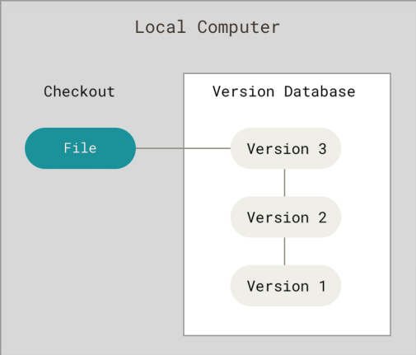
Central VCS (SVN)

Slide 14
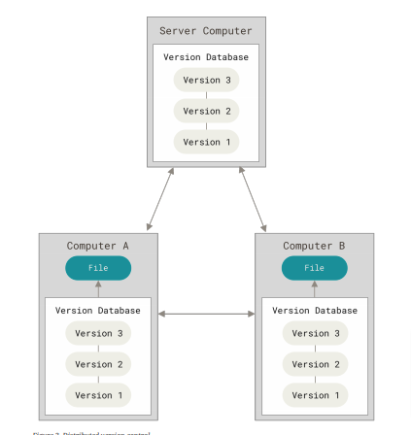
Distributed VCS (GIT)

Slide 15
FIRST TIME SETUP

Slide 16
INSTALLING GIT
Go to https://git-scm.com/

Slide 17
Check GIT version
git --version

Slide 18

GitHub
Code hosting platform for version control and collaboration.

Slide 19
Add Configuration variables
git config --global user.name "RushanKhan1"
git config --global user.email "rushan.khan2000@gmail.com”

Slide 20
Need Help?
git help <command>
git <command> --help

Slide 21
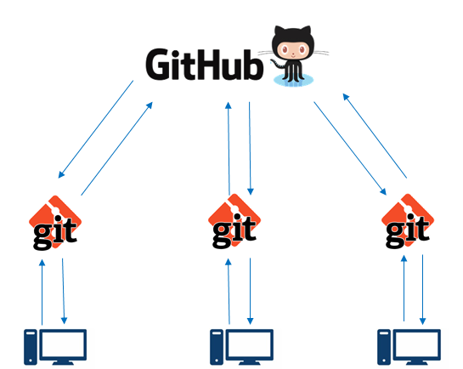
Git vs Github
Git | GitHub
Installed locally | Hosted in Cloud
Version Control System | Code Collaboration Platform
Git is Command Line Tool that requires an interface to interact with world | GitHub is Graphical Interface & Development Platform created for developers
It stores & catalog changes in code in Repository | It provides a platform as a collaborative effort to bring teams together

Slide 22
Let’s have a look at GitHub
www.github.com

Slide 23
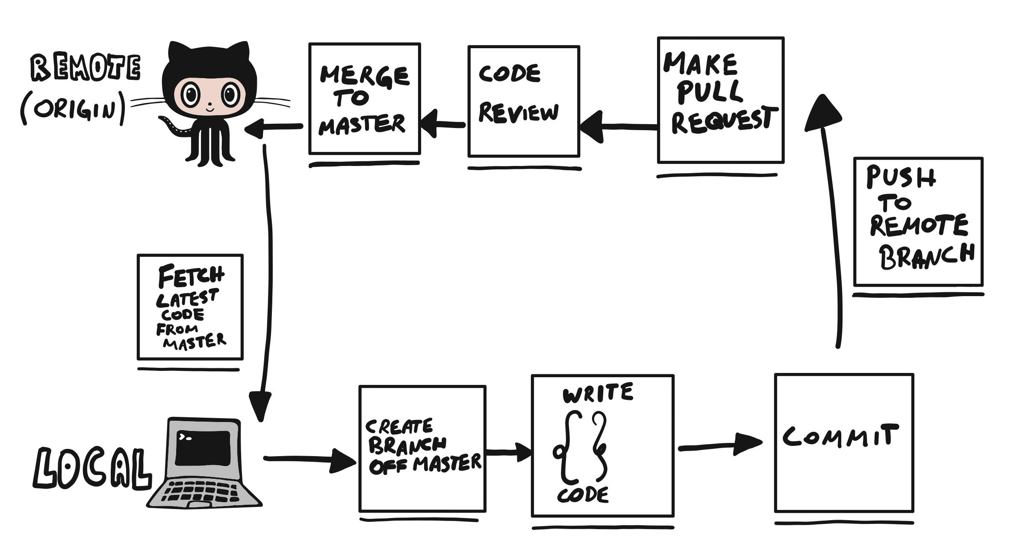
Sample GitHub Workflow

Slide 24
Initializing a git repository locally
git init
Checking the status
git status

Slide 25
Adding a .gitignore file
touch .gitignore
Sample .gitignore file
.DS_Store
.env
.project
*.pyc

Slide 26
Cloning a repo
git clone <url of the git file>
git clone ../remote_repo.git

Slide 27
Adding files to staging area
Removing files from staging area
git add <filename>
git add . (to add everything)
git reset <filename>
git reset
(to undo all changes)

Slide 28
Committing Changes (saving)
Seeing all the commits
git commit -m “This is the commit message.”
git log

Slide 29
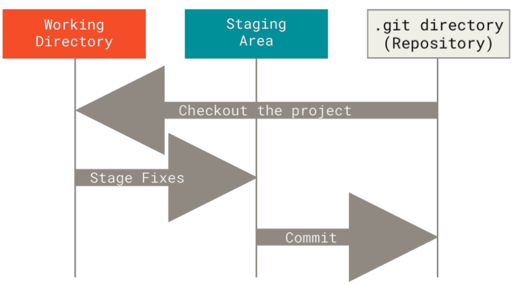
Where are we?

Slide 30
Pushing changes
git pull origin main
git push origin main

Slide 31
Making our first commit
git status
git add filename
git commit -m “Initial Commit”
git status
git push
git log

Slide 32
Viewing information
git remote -v
git branch -a

Slide 33
Working with branches
git branch -a
git branch newbranch
git checkout newbranch
git add .
git commit -m “new commit”
git checkout main
git merge newbranch
git branch -d newbranch
git push

Slide 34

GitHub Student Developer Pack

Slide 35




Open Source Programs
MLH Fellowship
Google Summer of Code
Linux foundation (lfn) mentorship program
Season of Docs

Slide 36



Outreachy
Season of KDE

Slide 37
Any Questions?

Slide 38
Resources
https://try.github.io/

Slide 39
Thank you for attending the workshop!
https://www.linkedin.com/in/rushankhan/
https://github.com/RushanKhan1/

